Slide 1
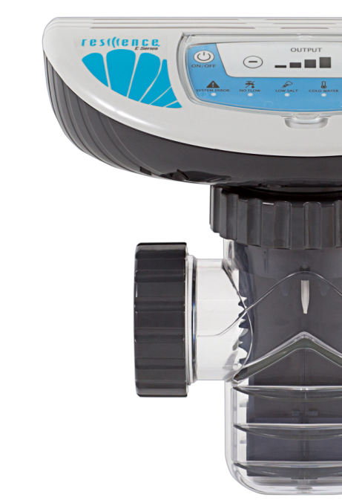
INTRODUCTION AND TRAINING

Slide 2
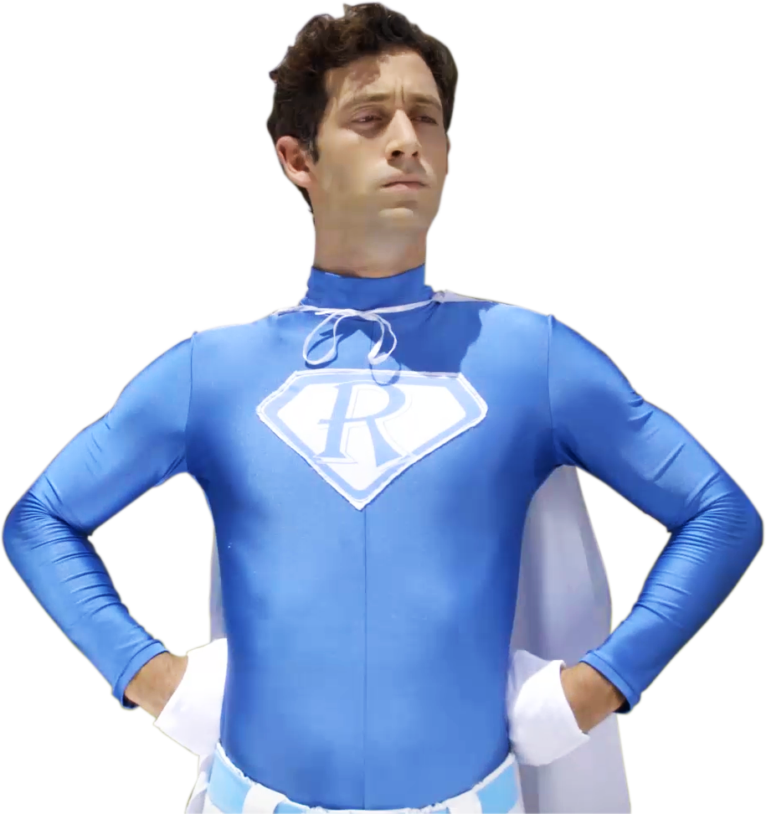
Revolutionary in-line salt chlorinator
2
2

Slide 3
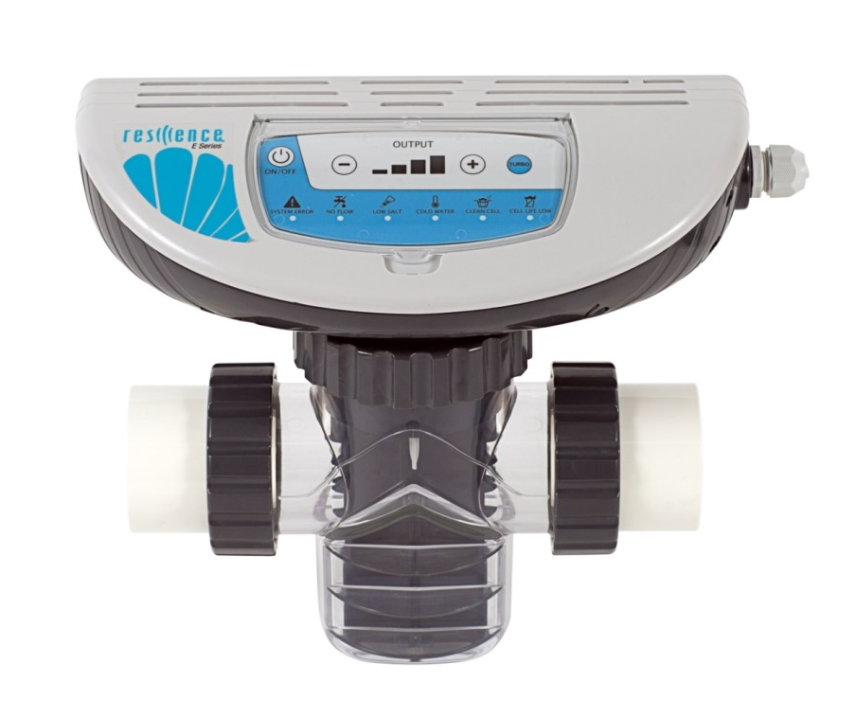
Leading the next generation of pool sanitizing systems
“All-in-one” device – encases all peripheral accessories
Simplest installation in the market
Designed to work with variable speed pumps
Bi-Directional flow protection
Full range input voltage 110$\sim$220 Vac
Built in salinity and water temperature sensors
Replaceable electrolysis cartridge
Double “low flow” protection mechanism (min. 20 GPM / 5 m³/hr)
Three models E18, E40, E60 – fits different pool size 18,000-60,000 gal/ 50m3- 150m3
3

Slide 4
Designed with the pool owner in mind
Control box
One pipe to cut and glue
Unique sliding slots for quick cartridge removal (no need to remove the entire device from the line)
Built in service and maintenance alerts. Easy to know when to clean/replace the cartridge
Replaceable electrolysis cartridge
Built in temperature & salinity sensors
Bi-directional flow sensor
4

Slide 5
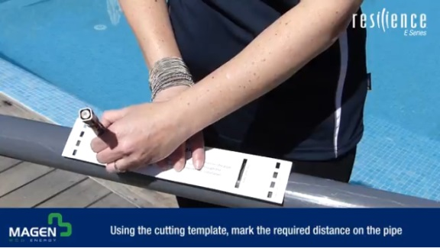
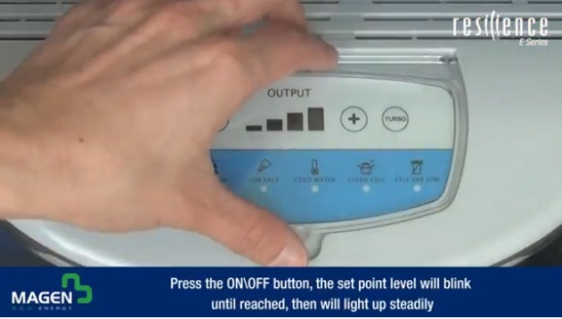
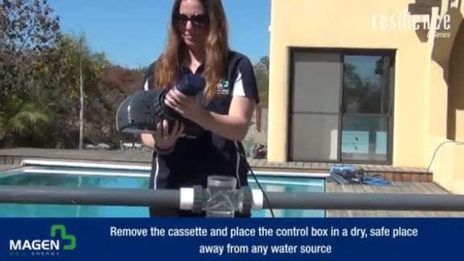
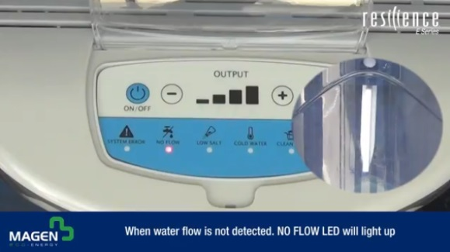
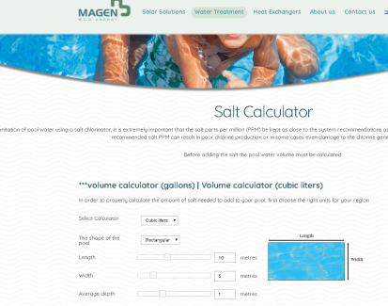
Videos
Installation
Basic operation
Cartridge cleaning
Replacing cartridge
Warnings
Salt calculator
All videos can be found at MEE’s YouTube channel or website
5

Slide 6
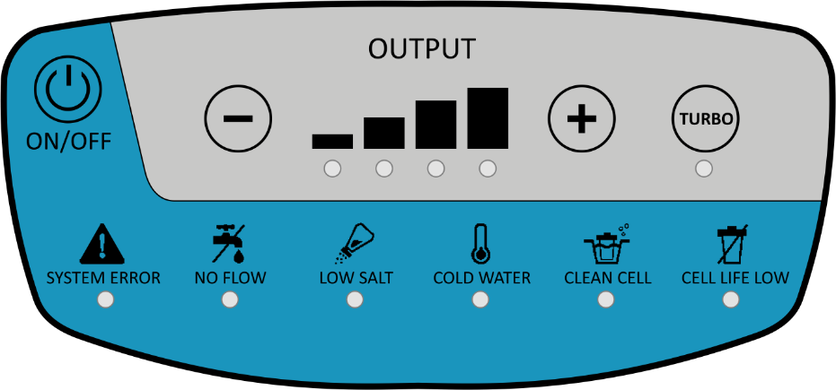
TROUBLESHOOTING
6

Slide 7
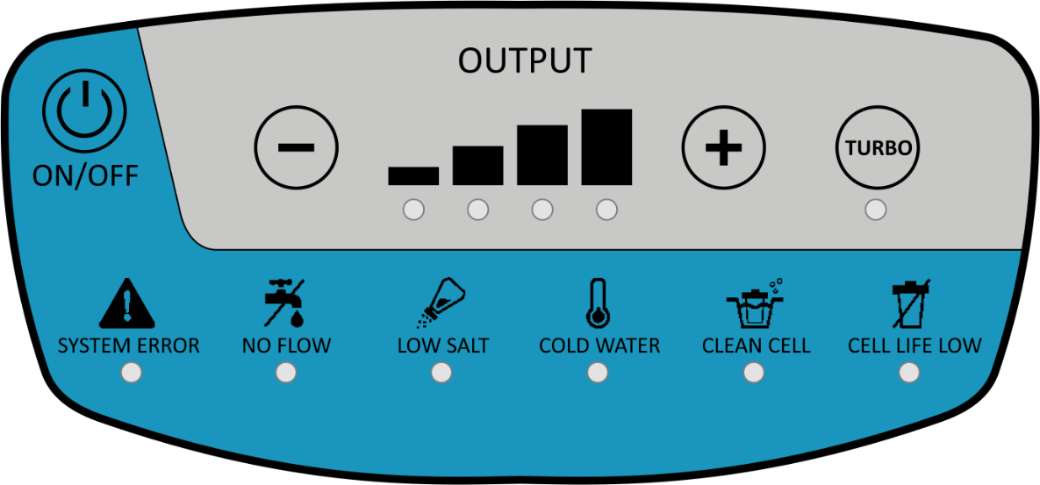
Before Troubleshooting
Check that the salinity in the pool water is above 2400 PPM.
Check for scale buildup on the cartridge and clean it if necessary.
Disconnect the plug, Dismantle the power box, connect the plug and check that all the LED is on for 1 sec. and then the system error LED is blinking.
Assemble and turn on the system – check if the problem solved.
7

Slide 8
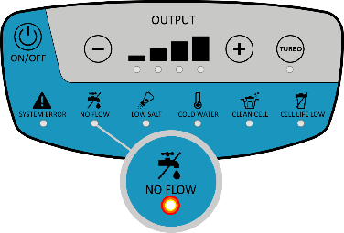
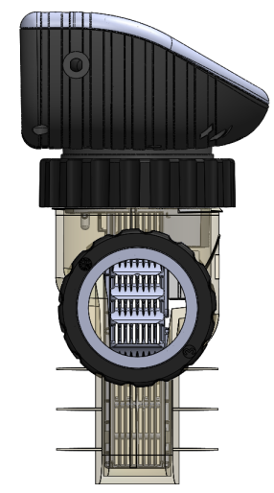
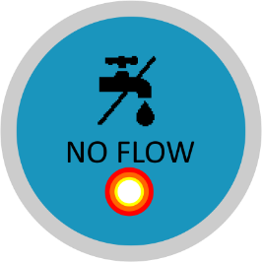
NO FLOW
LED “no flow” Turns On When:
Flow switch paddle is centered
And / OR
There are air bubbles in the salinity sensor
Gas bubbles
Possible Causes | What to do
Air bubbles form in the salinity sensor | This may happen if there is air in the pipe lines or for a few minutes at initial startup. Wait until air bubble disappear
 | Clean filters and strainers
 | Check for closed valves, pump cavitation, faulty pump etc.
 | In case you have a variable frequency pump installed, increase the flow until the LED is turned off
 | Slightly tilt the cell sideways to remove air bubble
Paddle is stuck at the center | Dismantle cartridge from cell body and remove scale build up. Refer to relevant chapter in manual or appropriate YouTube videos
Low salinity | Check pool salinity with a stick, if needed add salt according to the salinity table in the installation manual
Other | If none of the above resolves the problem replace cartridge
8

Slide 9
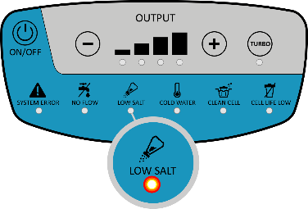
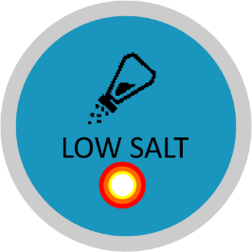
LOW SALT
LED LOW SALT Turns On when:
Measured water salinity levels are below 2400 ppm
Possible Causes | What to do
Not enough salt in pool water | Manually check the salinity of the pool water with a stick. If needed, add salt according to the salinity table in the installation manual
Scale build-up inside the cartridge | Visually inspect the cartridge for lime-scale. Clean blades if necessary refer to relevant chapter in manual or appropriate YouTube video
Air bubbles in the salinity sensor | See NO FLOW slide
Other | If none of the above resolves the problem replace cartridge
9

Slide 10
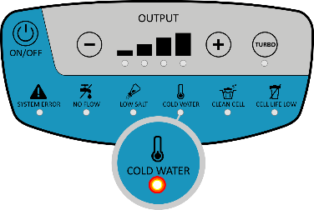
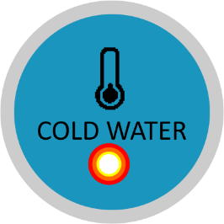
COLD WATER
LED Turns On when:
Measured Water temperature is below 68 °F –
When below 68 °F/ 20 °c - max. chlorine output level – 50%
When below 59 °F/ 15 °c - max. chlorine output level – 25%
Possible Causes | What to do
Water temperature is below 68 $°$F/ 20 °c | Manually check the water temperature. If water temp. is below 68$°$F system is OK. If water temp. is higher than 68$°$F then temp. sensor had failed
Temperature sensor failed | Replace cartridge. Refer to relevant Youtube video
10

Slide 11
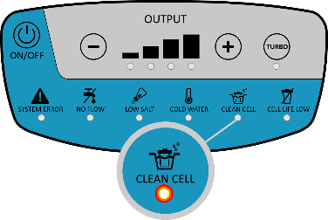
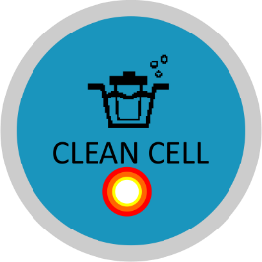
CLEAN CELL
LED Turns On when:
Chlorine output level doesn’t reach the set point and the following parameters are OK:
Salinity levels above 2400 ppm
Water temperature above 68 °F
Possible Causes | What to do
Scale build-up inside the cartridge | Clean cartridge, refer to relevant chapter in manual or appropriate YouTube video
Low salinity | Increase salinity levels to 3500-4000 ppm
Worn cartridge | If none of the above resolves the problem replace the cartridge with a new one. Refer to relevant YouTube video
11

Slide 12
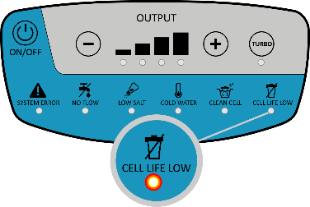
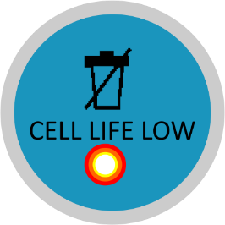
CELL LIFE LOW
LED Turns On when:
Cell operating hours above 8000, Chlorine output level doesn’t reach the set point and the following parameters exist:
Salinity levels above 2400 ppm
Temperature water above 68 °F
Possible Causes | What to do
Scale build-up inside the cartridge | Clean cartridge, refer to relevant chapter in manual or appropriate YouTube video
Low salinity | Increase the salinity levels to 3500-4000 ppm
Blades are worn | If none of the above resolves the problem replace the cartridge with a new one (check warranty). Refer to relevant YouTube video
12

Slide 13
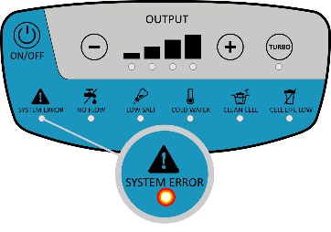
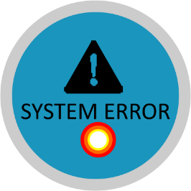
SYSTEM ERROR (blinking) LED
LED is Blinking when:
No communication is detected between the cartridge and control box
Possible Causes | What to do
Incorrect assemble of the power box | Assemble correct refer to relevant chapter in “clean cartridge” YouTube video
Debris is stuck in the electrical connection of the cartridge | Clean cartridge, refer to relevant chapter in manual or appropriate YouTube video
Communication problem between the cartridge and control box | Replace the cartridge, if problem is not resolved replace the control box
13

Slide 14
SYSTEM ERROR (constant) LED
Turns on when:
The control box can’t deliver power (current) to the cartridge.
Possible Causes | What to do
Salinity High, too much salt has been added | Test salt levels in pool water, if high, it is recommended to drain part of the pool water and refill with fresh water
Low salt levels | Manually check the salinity of pool water with a stick. If needed, add salt according to the salinity table in the manual
Debris in electrical connector of the cartridge | Disconnect the control box from cartridge and visually inspect the electrical connector. In case debris has settled there, gently remove it and re-attach
Worn cell/scale build up | Visually inspect the cartridge to see if blades are dirty or damaged. If dirty, clean cartridge. Refer to relevant chapter in manual or appropriate YouTube video
A more profound error occurred | Dismantle the power box and turn on if the System Error LED is not blinking replace the power box. If it is blinking - Replace the cartridge, if the problem isn’t resolved - replace the control box . Refer to relevant YouTube videos
14

Slide 15
No Display (power supply does not turn on)
Possible Causes | What to do
System is turned off | Turn the system on
Power supply is disconnected | Connect the plug into socket
Circulation pump is off | Unit should be wired in such a way that it operates only when the circulation pump is on, verify that pump is in fact operating
Other malfunction in the unit | Replace control box
15

Slide 16
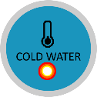
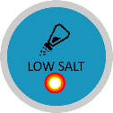
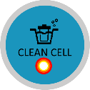
Chlorine Output levels does not reach 100%
Possible Causes | What to do | Display (LED)
Output level set too low | Press the "+" button to set the output level to a higher setting
Low pool water temperature | In case Cold Water LED is on refer to slide 9
Not enough salt due to heavy rain, initial miscalculations etc. | In case Low Salt LED is on, refer to the Low Salt warning - slide 8
Overheating protection | In extreme conditions, when the unit identifies overheating it will automatically reduce chlorine production to protect itself
Scale build-up inside cartridge | Clean cartridge, refer to relevant chapter in manual or appropriate Youtube video
Worn cartridge | If none of the above resolves the problem the cartridge may be worn and requires replacing
16

Slide 17
LEAKING
Possible Causes | What to do
Side/Top nut leaking | Tight the nut
 | Replace the O-ring
TOP NUT CRACKED/BROKEN
Possible Causes | What to do
Production problem – Old version | Replace control box and the O-ring to the latest version
17

Slide 18
Thank you!

